Slide 2
KNP Task Group S 2296 Loop Cards
An entry in the Structuring strand of the KNP Intervention Guide

Slide 3
Purpose
S 2296
Develop computational fluency within 20

Slide 4
Connections to CCSS
S 2296
Activity Number | Fluency Standard | Other Standards
S 2296.0 | K.OA.5 – Add and subtract fluently within 5 | K.CC.4, K.CC.5
S 2296.1 |  | K.CC.4, K.CC.5, K.OA.2
S 2296.2 | 1.OA.6 - … demonstrating fluency for addition and subtraction within 10 | K.CC.4, K.CC.5
S 2296.3 |  | K.OA.2, K.OA.4, 1.OA.8
S 2296.4 | 2.OA.2 – Fluently add and subtract within 20… | K.CC.5, 1.NBT.1, 1.NTB.2
S 2296.5 |  | 1.OA.6, 1.OA.8

Slide 5
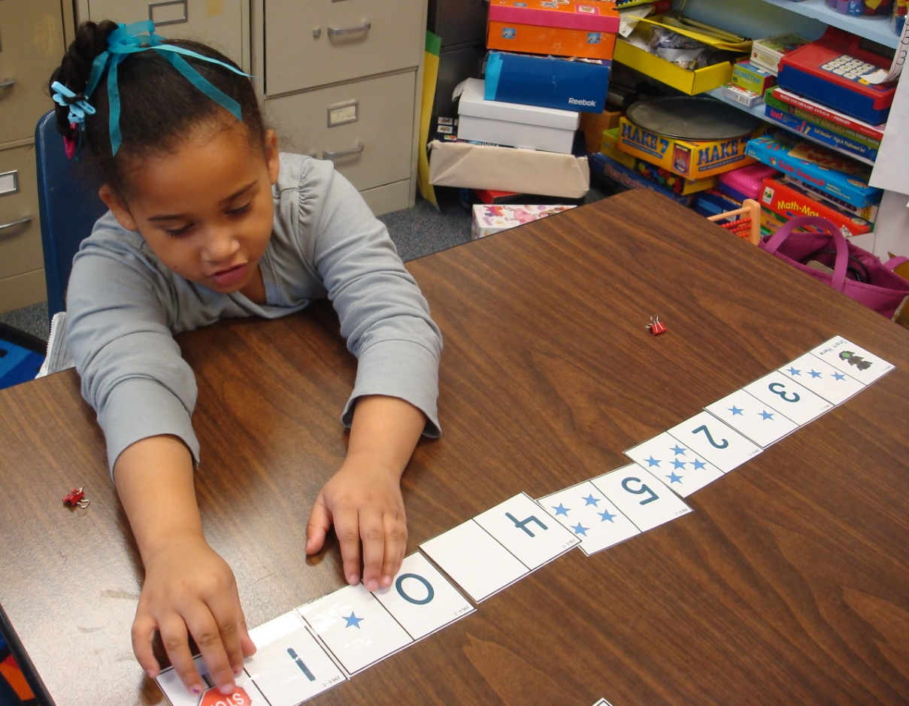
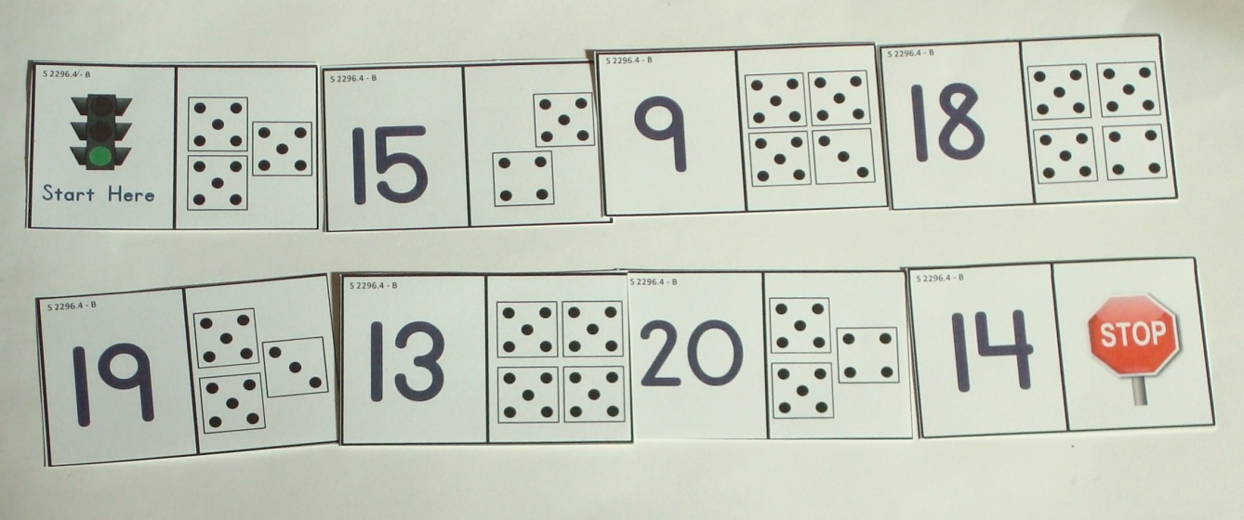
Setting: Loop Card Puzzles
S 2296
Each activity consists of 3 to 8 loop card puzzles.
Puzzles can be completed individually, by partners or in small group.

Slide 6
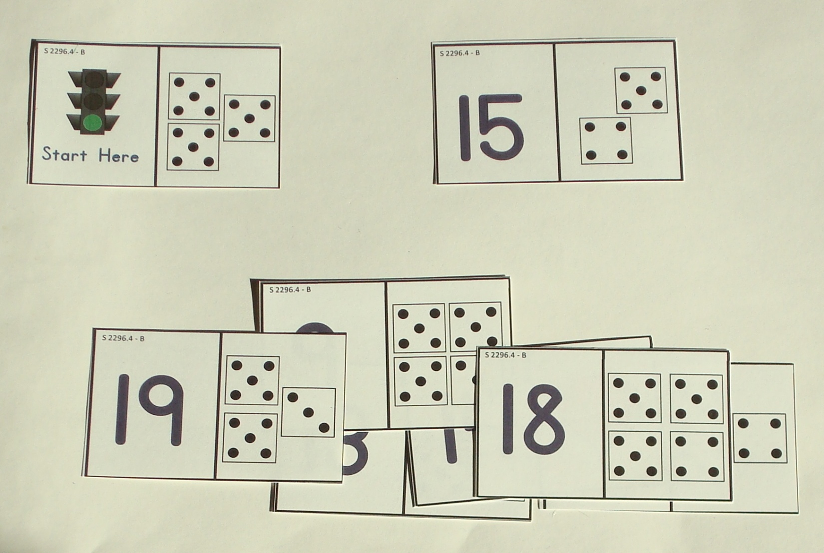
Loop Card Puzzles
S 2296
Use the right side of the card to determine the next card.
Every puzzle starts with the “green light” card.
Next card will be a “9”

Slide 7
Loop Card Puzzles Continued
S 2296
Final card will end in a “Stop Sign”
Continue by matching the right side of the card to the left of the next card

Slide 8
Levels of Play
S 2296
Activity Number | Range | Type
S 2296.0 | Up to 5 | Regular Spatial (Dice) Patterns
S 2296.1 |  | Irregular and 2 color patterns; Symbolic – matching expressions to dots, addition
S 2296.2 | Up to 10 | Ten frames and Dot patterns
S 2296.3 |  | Symbolic – equations with a missing term
S 2296.4 | Up to 20 | Dot arrangements
S 2296.5 |  | Symbolic – equations with a missing term

Slide 9
Preparing the Loop Card Puzzles
S 2296
Loop Card Puzzles are available through the “print link”.
Print pages (in color or B&W). Cut apart cards.
Each set has a unique code. Every card in the set is labeled with that code.
Also, sets will have a consistent color scheme.

Slide 10
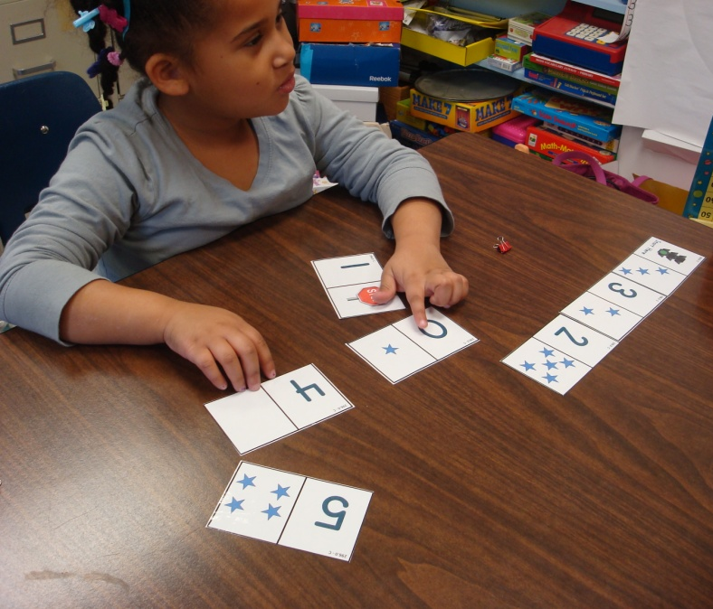
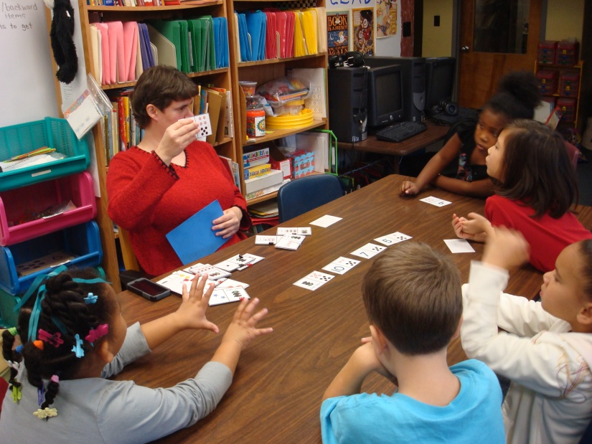
Options for Use
S 2296
Individual
Partners
Small Group

Slide 11
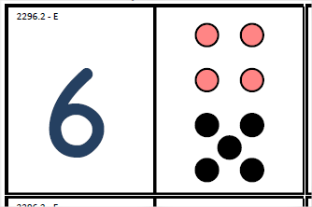
Small group
S 2296
Introduce activity
Allows teacher to screen and flash quantities
Questions:
What did you see?
Can you show me on your fingers?
How many red/black?
How many in all?
What card is next?

Slide 12
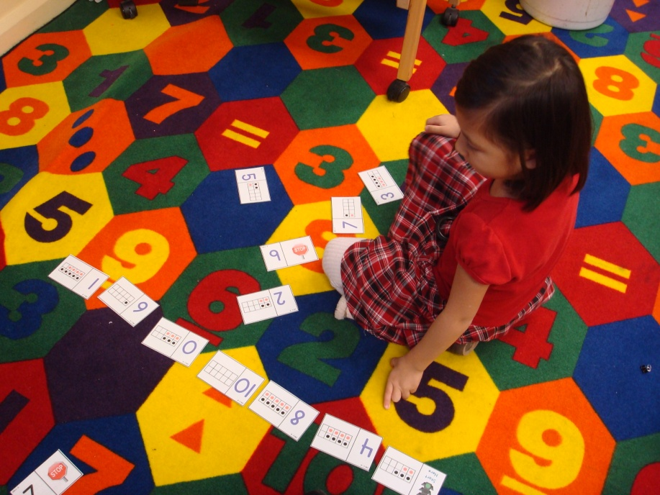
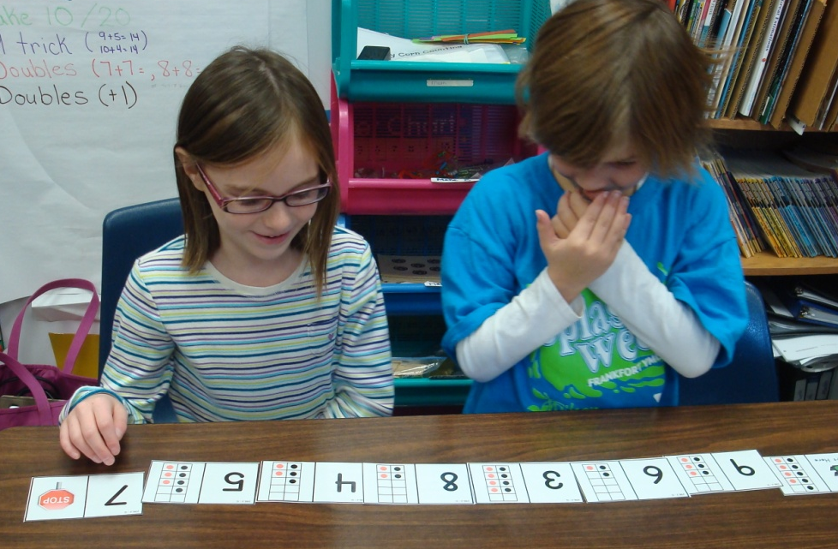
Individual or Partner Play
S 2296
Choose an appropriate level for the student(s)
Clarify expectations
Work out a system for checking student work and getting a new set
Notice students’ strategies for solving
Tip – Shuffle cards after each use so that they will be ready for the next use!

Slide 13
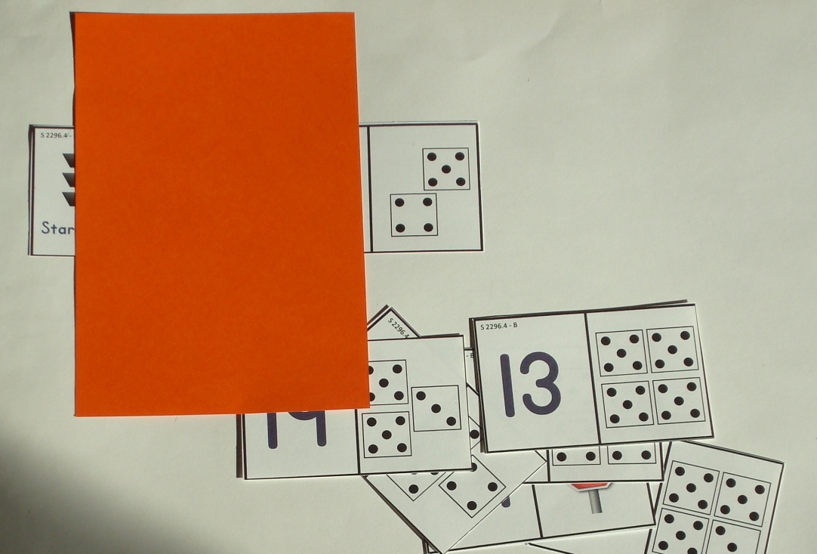
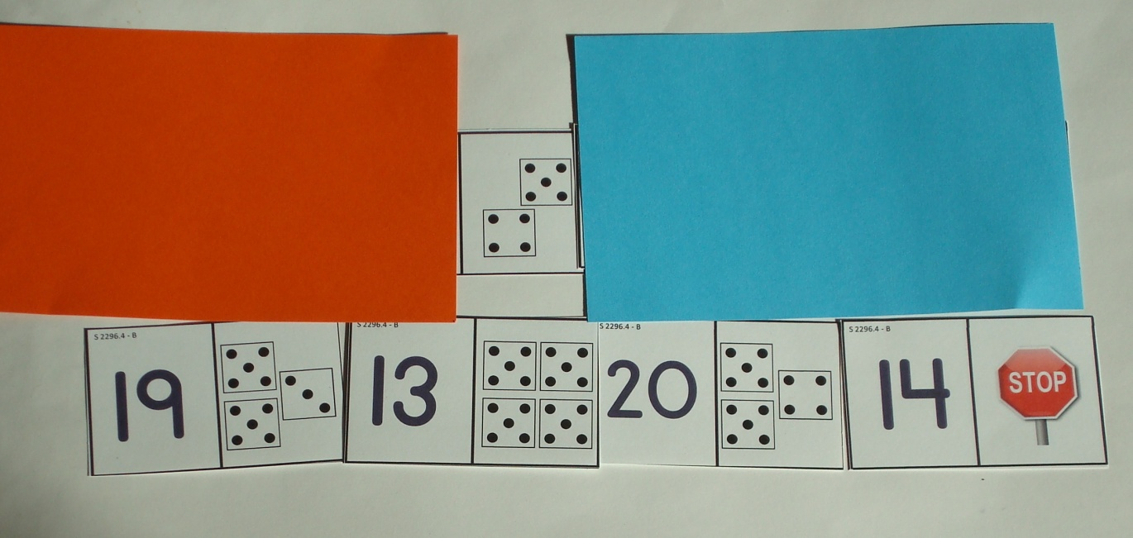
Individual or Partner Play
S 2296
If students have a difficult time attending to only the right hand side, model using a screen to minimize distractions.
A second cover can be used to briefly show, then screen, the amount being considered.
Can be used by the teacher as part of the “checking” process.
Observe if students can subitize (quickly recognize) amounts or if the students are counting to solve.
Teacher asks “What’s behind here?”

Slide 14
Levels of Play
S 2296
Activity Number | Range | Type
S 2296.0 | Up to 5 | Regular Spatial (Dice) Patterns
S 2296.1 |  | Irregular and 2 color patterns; Symbolic – matching expressions to dots, addition
S 2296.2 | Up to 10 | Ten frames and Dot patterns
S 2296.3 |  | Symbolic – equations with a missing term
S 2296.4 | Up to 20 | Dot arrangements
S 2296.5 |  | Symbolic – equations with a missing term

Slide 15
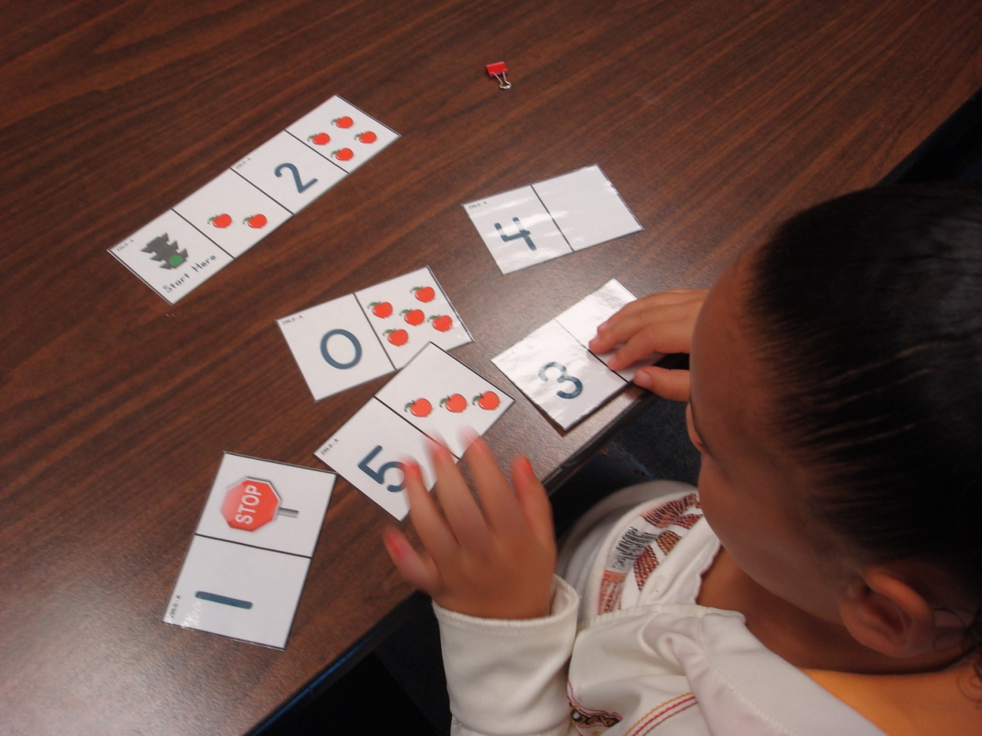
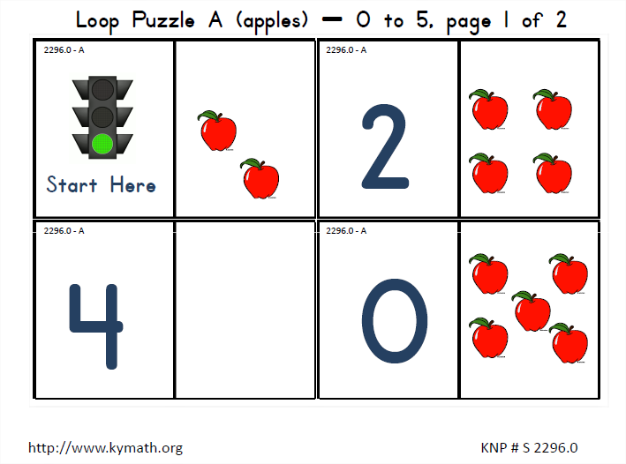
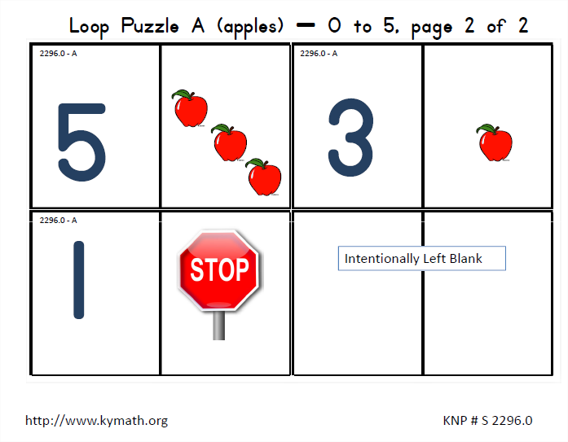
S 2296.0
Regular spatial pattern to 5 is matched to a numeral (0 to 5)

Slide 16
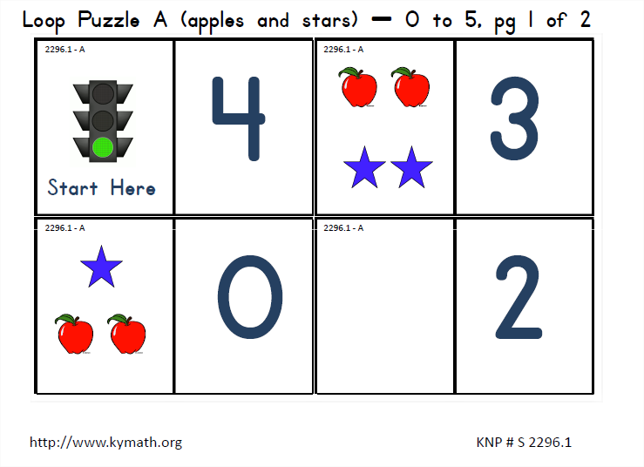
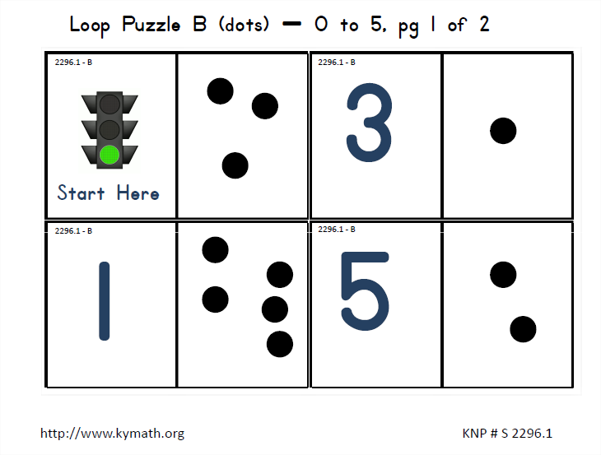
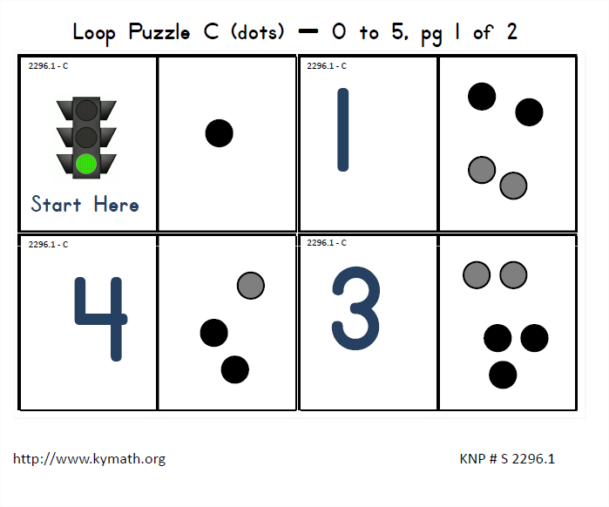
S 2296.1
Range is within 5
Collections are irregular and/or composed of 2 groups
Numeral or Quantity may be shown on right side of card.

Slide 17
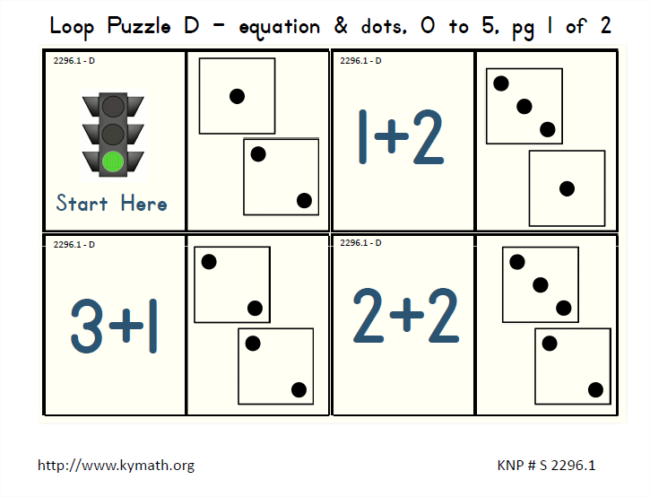
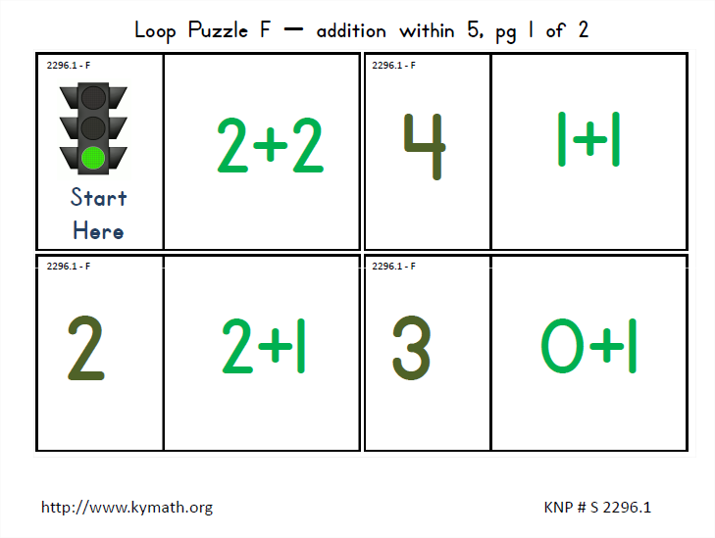
S 2296.1
Puzzles that involve using symbolic expressions
Matching a quantity to an expression
Matching an expression to a quantity
Solving a simple expression

Slide 18
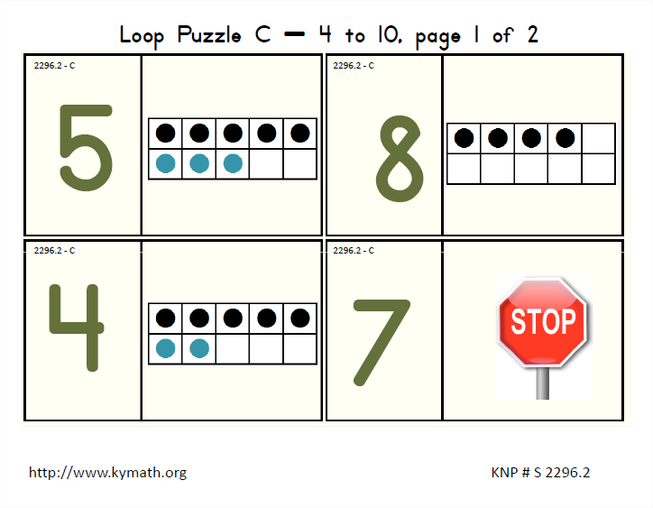
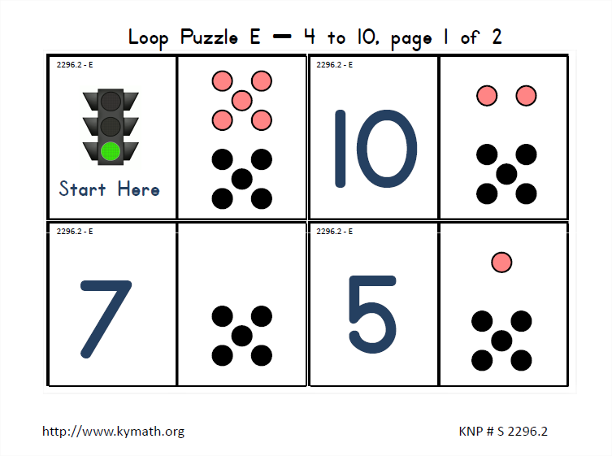
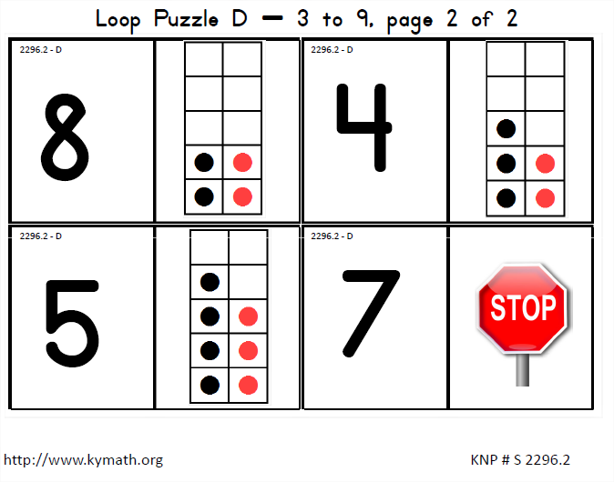
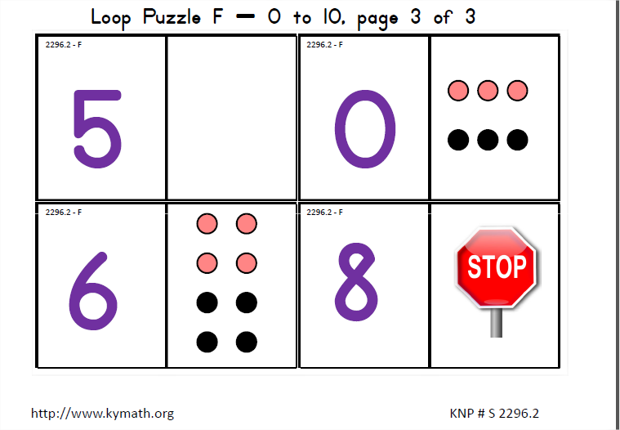
S 2296.2
Range is within 10.
Match a quantity to a numeral
10 frames and Dot Patterns
Five-wise arrangements
Pair-wise arrangements

Slide 19
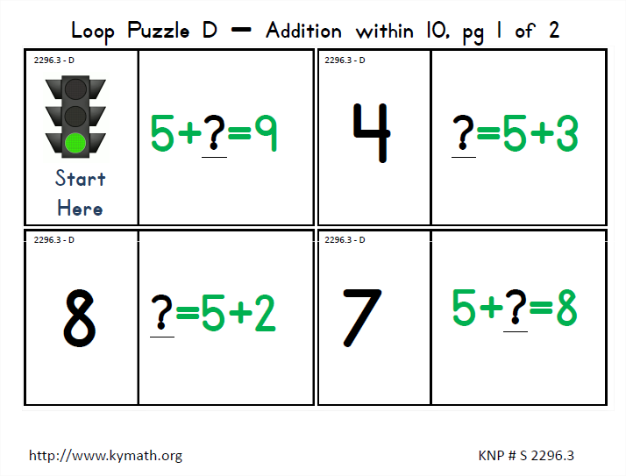
S 2296.3
Range is within 10
Students solve for a missing term in an equation

Slide 20
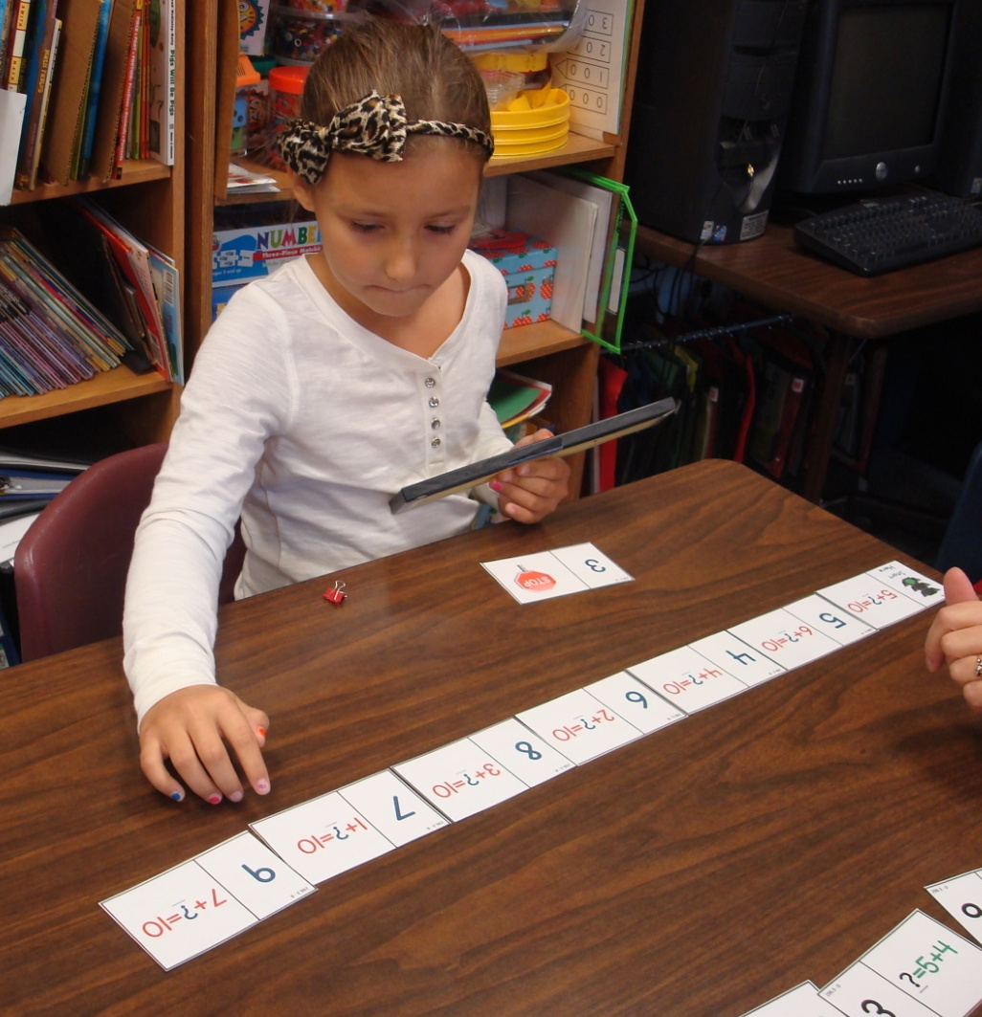
S 2296.3
Students may find it useful to use finger patterns or a bead rack.

Slide 21
S 2296.4
Range is within 20
Quantities are shown
ten-wise
pair-wise

Slide 22
S 2296.5
Range is within 20
Students solve for a missing term in an equation
Students may find bead racks helpful.

Slide 23
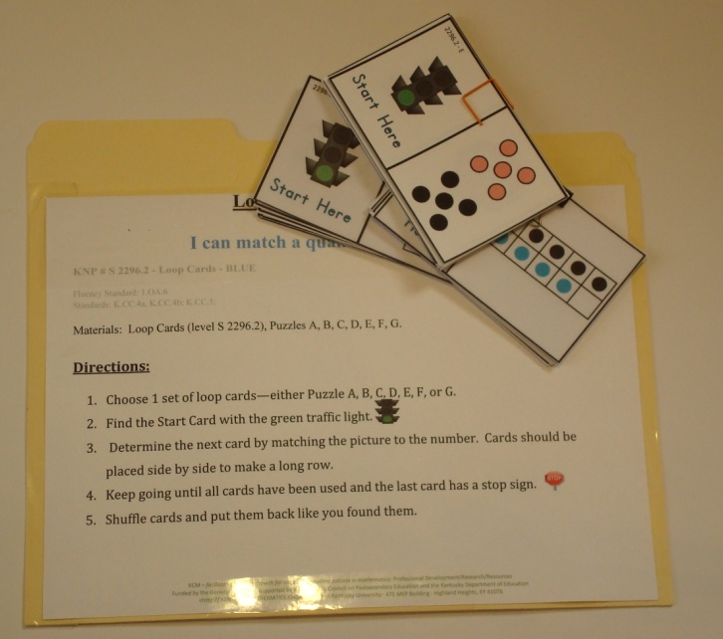
Activity Folders
Student friendly directions are available.
Puzzles can be stored inside a folder!

Slide 24
Thank You!
Please visit knp.kentuckymathematics.org for more information.

