Slide 1


Kentucky Center for Mathematics
knp.kentuckymathematics.org

Slide 2
KNP Task Group Ni 1181
Discriminating Numerals
An entry in the Numeral Identification strand of the KNP Intervention Guide

Slide 3
Numeral Identification
Numeral Recognition
Ni 1181
Can you tell me what number this is?
5
Can you tell me which number is the “five”?
4, 8, 2, 5, 7, 1, 6
That’s a “five”.
There!

Slide 4
Purpose
Ni 1181
Intervention activity to target a specific type of student difficulty with Numeral Identification
  Student uses the same number name for two or more numerals (e.g., uses “twelve” to name both “12” and “21”)
  Student frequently switches numeral names between two numbers (e.g., frequently uses “nine” to name “6” and vis-a-versa.)

Slide 5
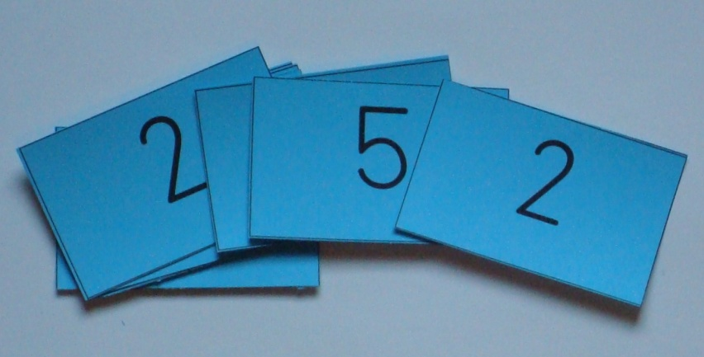
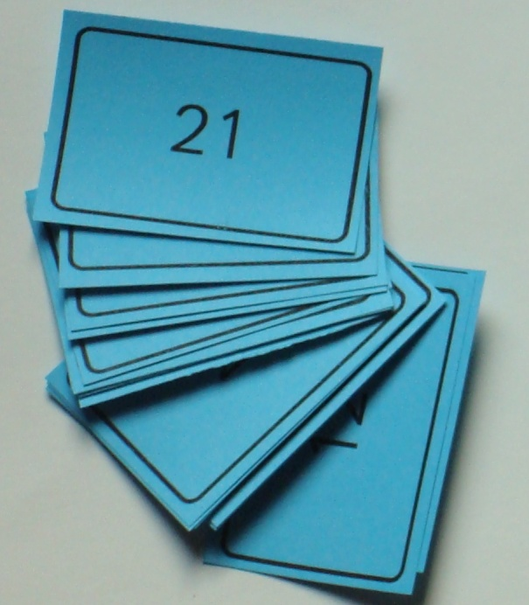
Setting
Ni 1181
Numeral Cards – At least 5 copies each of 2 numbers
Choose pairs of numbers to target a student’s specific struggle (ex. 2 & 5 or 12 & 21)

Slide 6
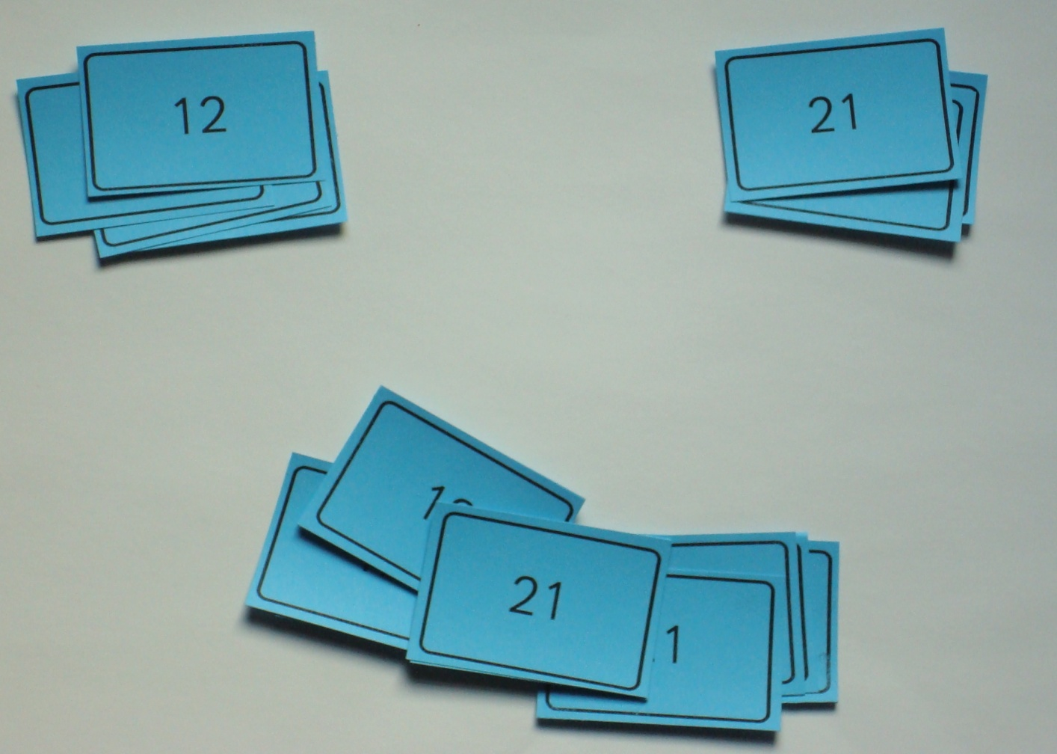
Activity
Ni 1181
Scatter cards
Student will sort the cards, creating a pile for each numeral.
Ask student to name each numeral as it is being placed in the appropriate pile.
Scatter cards before sorting

Slide 7
Differentiation
Ni 1181
Level | Task Entry | Range of Numerals | Numerals to Consider
0 | Ni 1181.0 | Up to 5 | Common name reversal: 2 & 5
1 | Ni 1181.1 | Up to 10 | Common name reversals: 6 & 9; 1 & 7; 3 & 8
2 | Ni 1181.2 | Up to 20 | Common name reversal: 13 & 15
3 | Ni 1181.3 | Up to 100 | Common name reversals: 12 & 21 (or calling both numerals “twelve”); 12 & 20, 13 & 31, etc.
4 | Ni 1181.4 | Up to 1000 | Common struggle: knowing how to read the “0” in a 3 digit numeral (i.e. may say “thirty four” for “304”) suggested numerals are 34, 304 & 340

Slide 8
Standards
Ni 1181
Task Entry | Range of Numerals | Standard
Ni 1181.0 | Up to 5 | K.CC.3 - Write numbers from 0 to 20. Represent a number of objects with a written numeral 0-20 (with 0 representing a count of no objects).
Ni 1181.1 | Up to 10
Ni 1181.2 | Up to 20
Ni 1181.3 | Up to 100 | 1.NBT.1 - Count to 120, starting at any number less than 120. In this range, read and write numerals and represent a number of objects with a written numeral.
Ni 1181.4 | Up to 1000 | 2.NBT.3 - Read and write numbers to 1000 using base-ten numerals, number names, and expanded form.

Slide 9
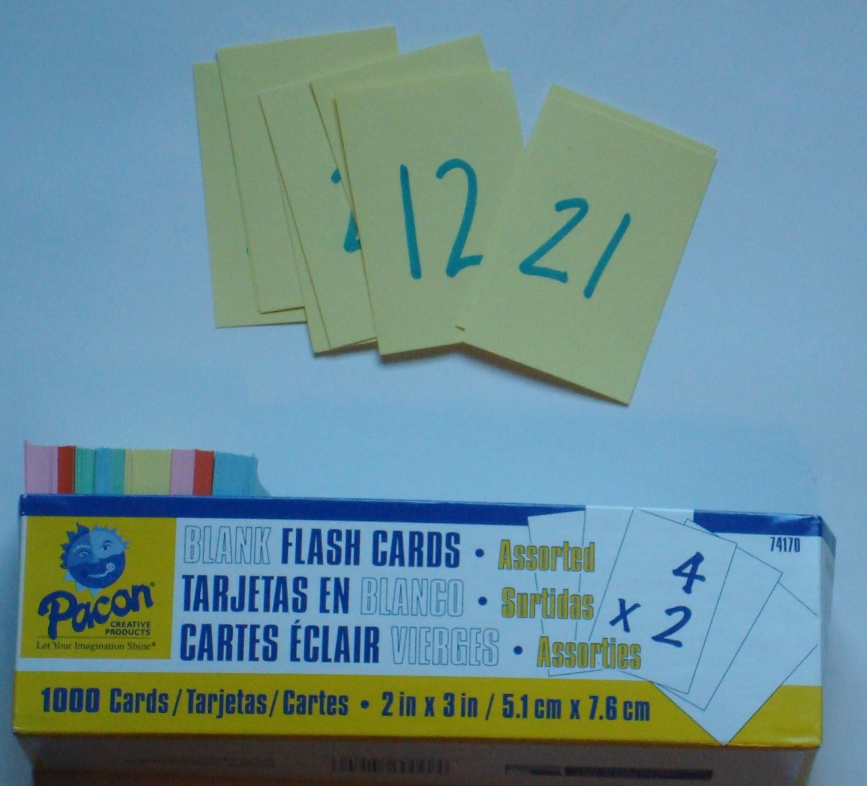
Create your Setting – Option 1
Ni 1181
Write numerals on pre-cut 2 x 3 flash cards (or halved index cards)

Slide 10
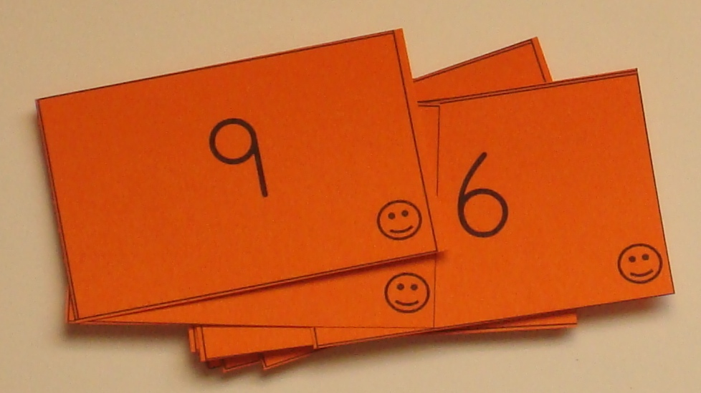
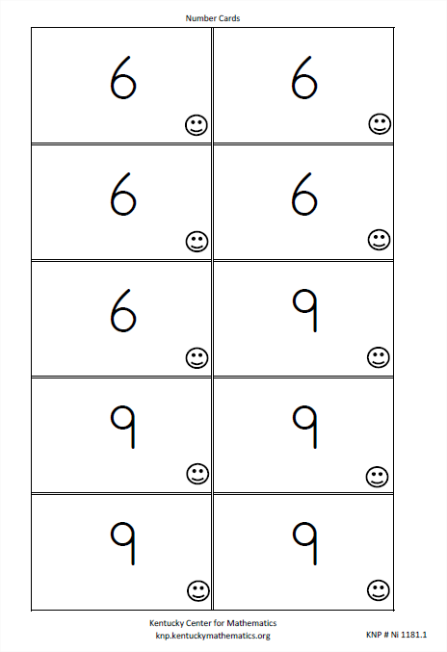
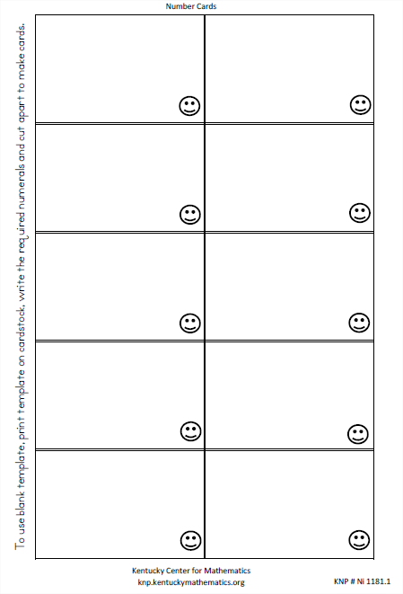
Create your Setting – Option 2
Ni 1181
Use the masters available by print link.
If a deck with the numerals you wish to use is not included, hand-write numerals on the blank template to make cards.
Smiley face indicate correct orientation.
Examples from Printable for Ni 1181.1

Slide 11
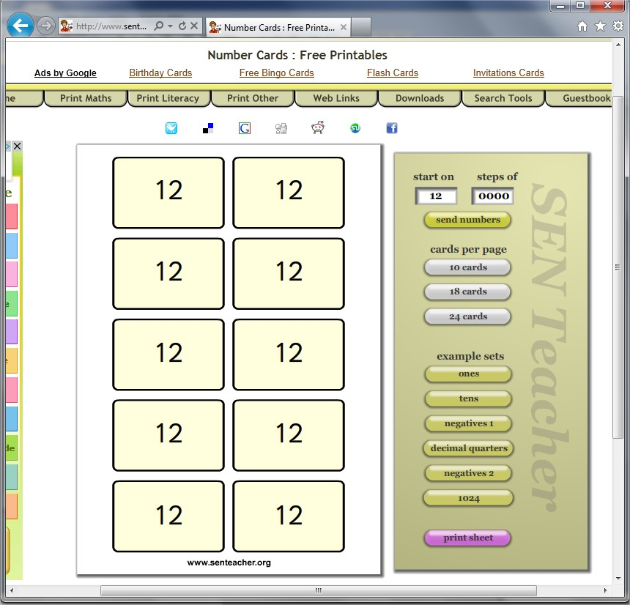
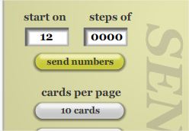
Create your Setting – Option 3
Ni 1181
Use the Sen Teacher Card Maker at http://www.senteacher.org/Worksheet/9/Number.xhtml
Set “Steps of” to “0”

Slide 12
Questioning
Ni 1181
What is different about these numbers?
How do you know that number goes in that stack?
Which one comes first when you count?
Which one is more/less?

Slide 13
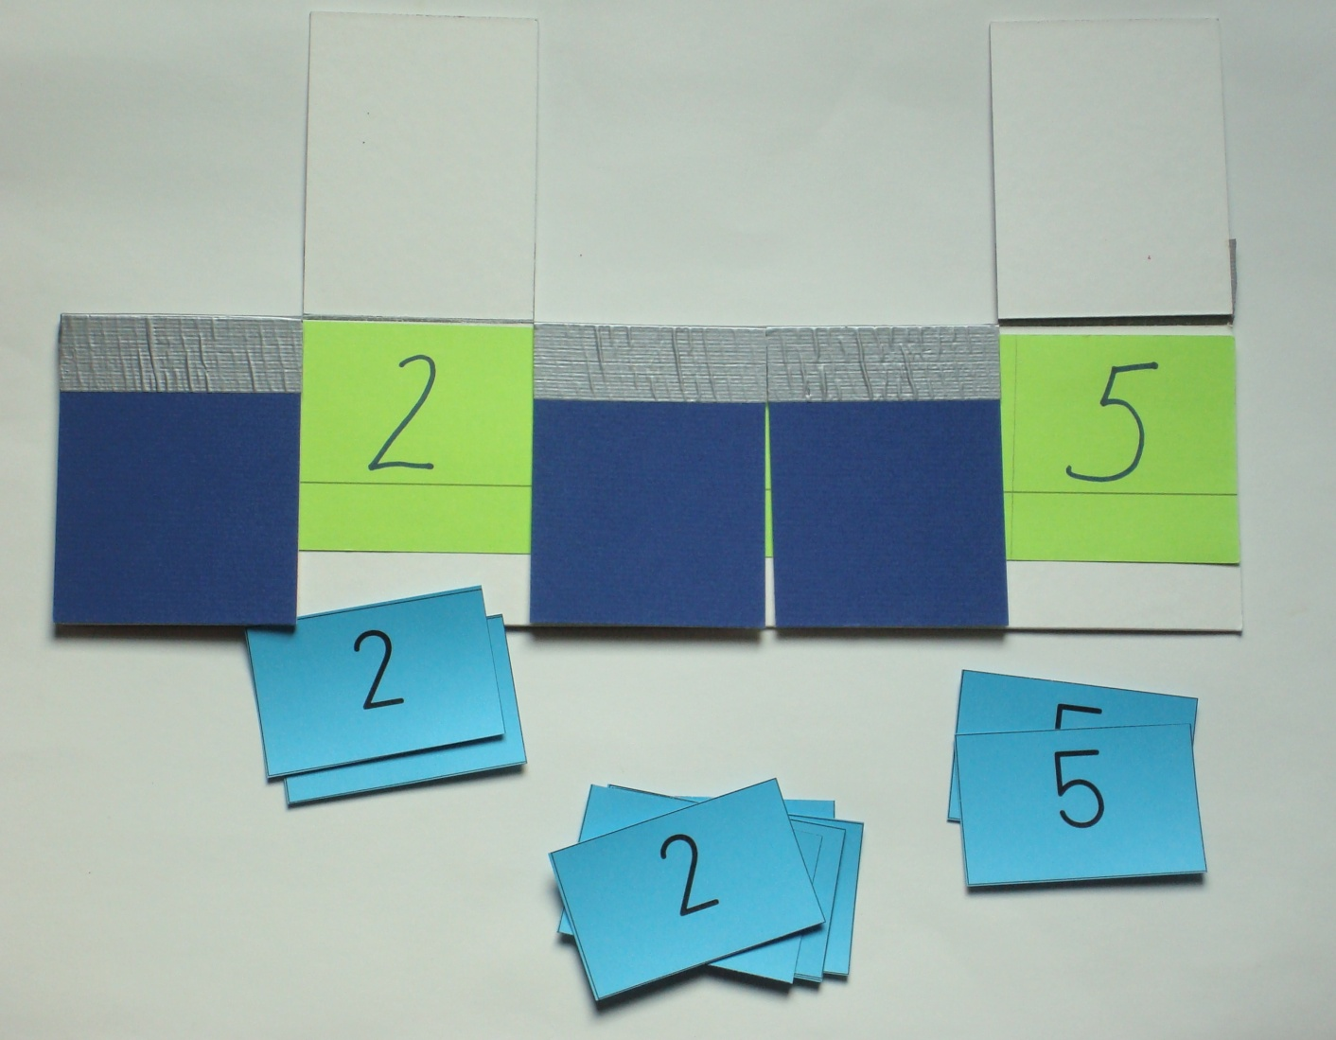
Additional Support – Numeral Track
Ni 1181
For pairs of numbers within a small range – a Numeral Track can be used as a reference.

Slide 14
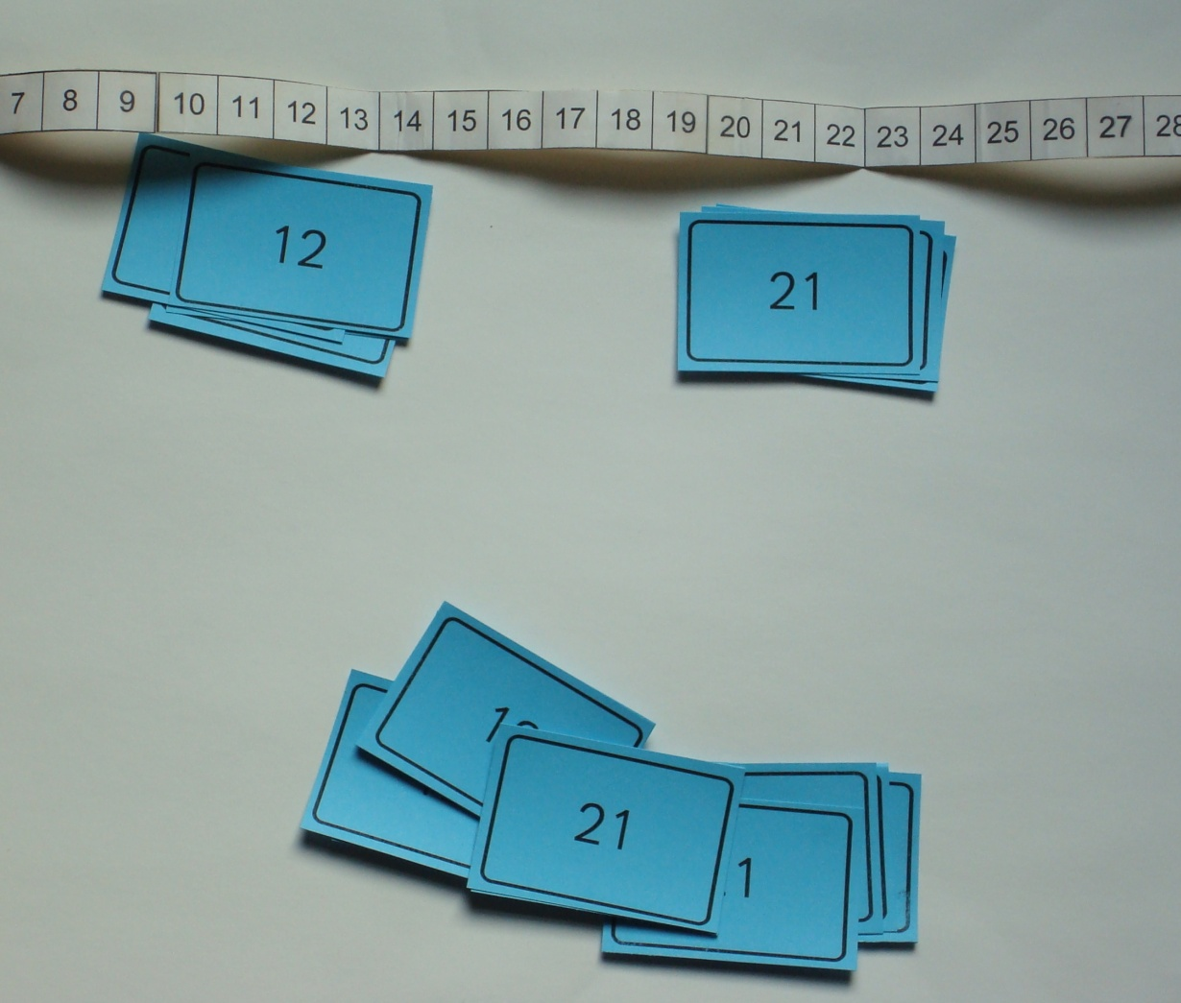
Additional Support – Numeral Roll
Ni 1181
For larger numerals (within 100), a Numeral Roll may be supportive.
For some struggling students, finding the number’s position may provide the support a student needs
Notes:
Replace with a picture of a 2 color numeral roll!

Slide 15
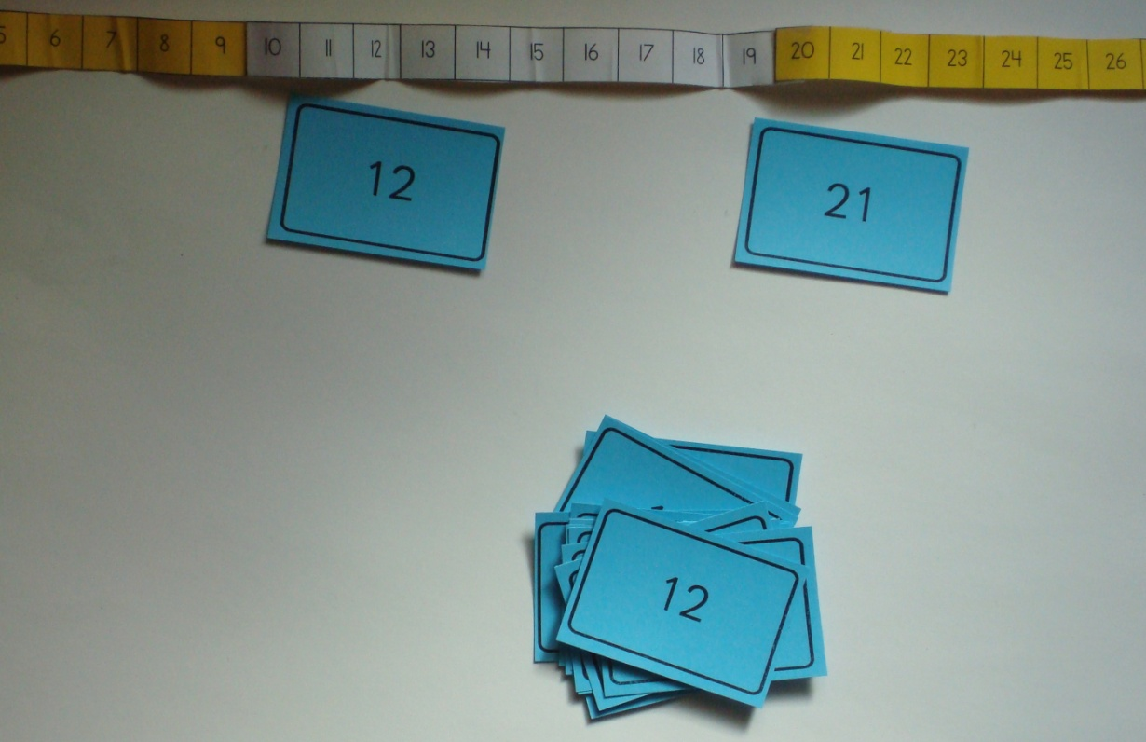
Questioning
Ni 1181
Where is that number located?
To which decade family does it belong?
What numbers are its neighbors?
Visit this site to learn how to make a numeral roll:
http://www.kentuckymathematics.org/intervention/KNP-NumRoll.asp

Slide 16
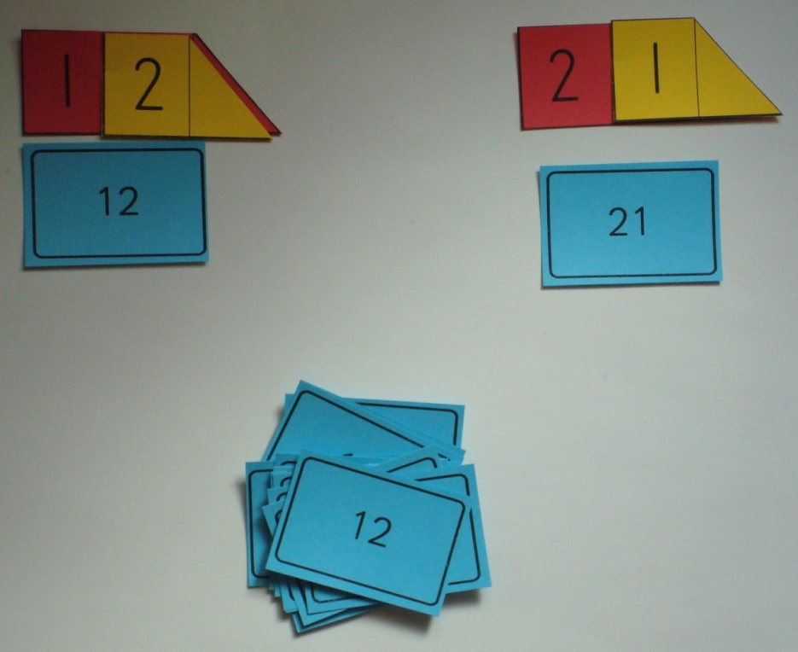
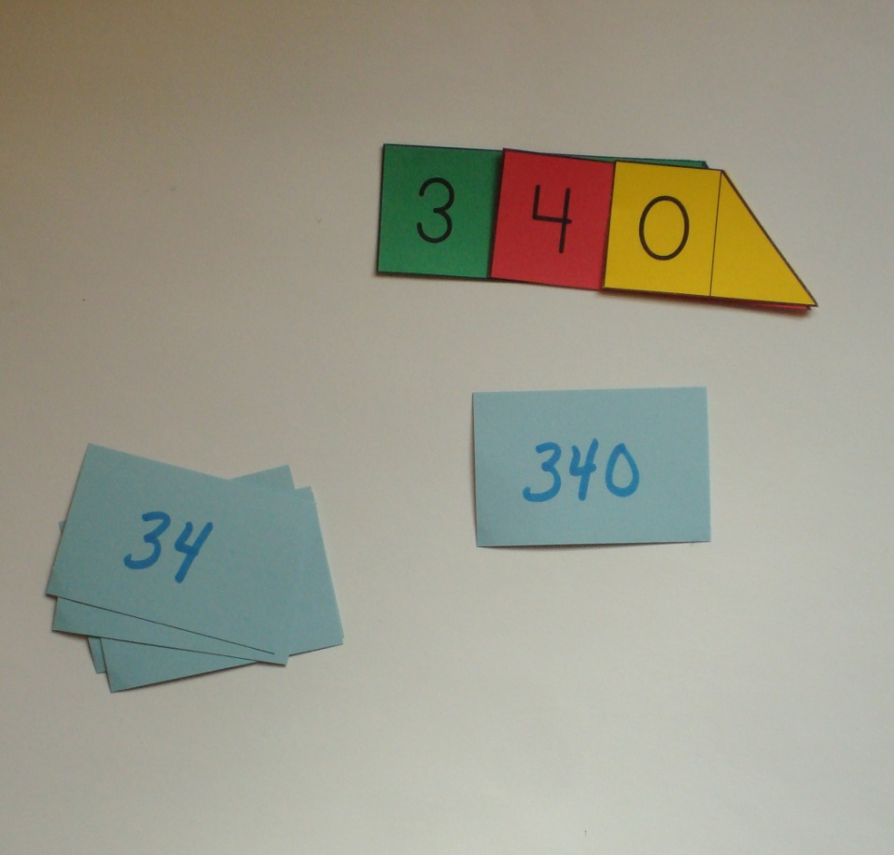
Additional Support – Arrow Cards
Ni 1181
Some students may benefit from building the numerals with Arrow Cards.

Slide 17
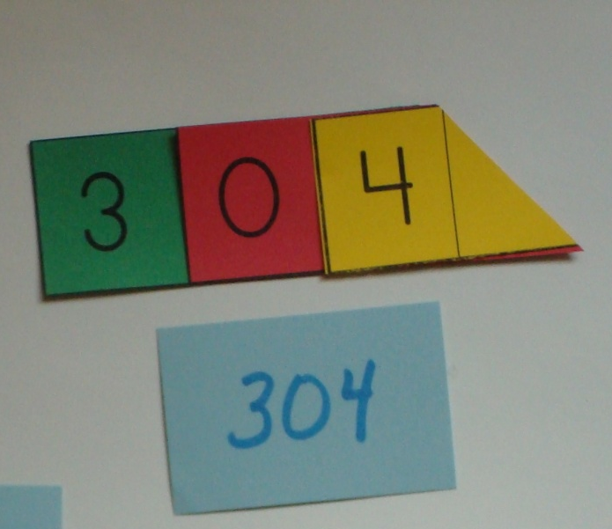

Questioning
Ni 1181
Build each number with the arrows.
How are they different? How are they the same?
Read the arrows…. Does that help you read the number?
What does the 3 mean in that number?

Slide 18
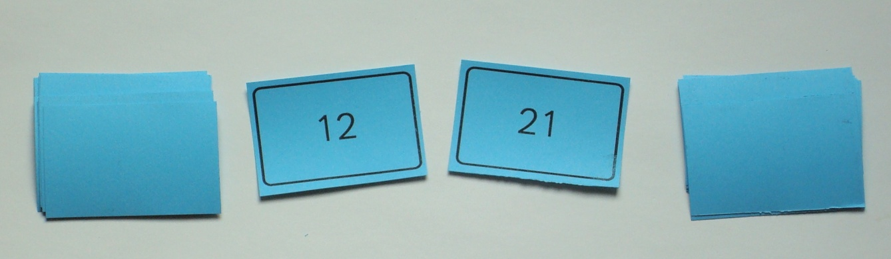
Extensions – Beyond sorting!
Ni 1181
Speed name – turn cards over one at a time and have student name the numeral. Set a timer and challenge student to name the numbers more quickly next time.
Add additional number(s). For example, add “20” or “11” to the deck consisting of 12 & 21.
Play games with the deck. For example, play “war” (or “Number Battle”).

Slide 19
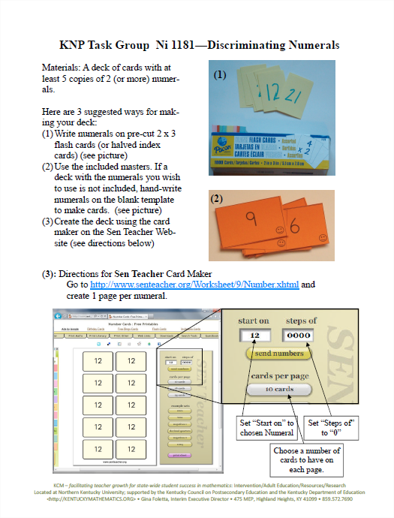
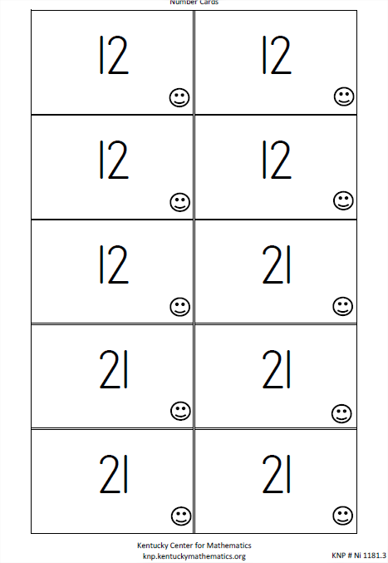
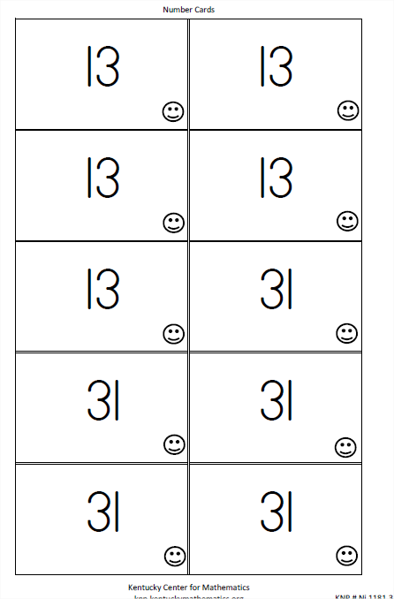
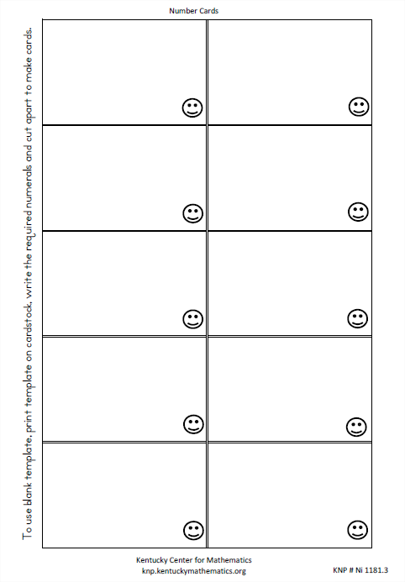
Printables
Ni 1181
Includes handy reference sheet and game card masters!

Slide 20
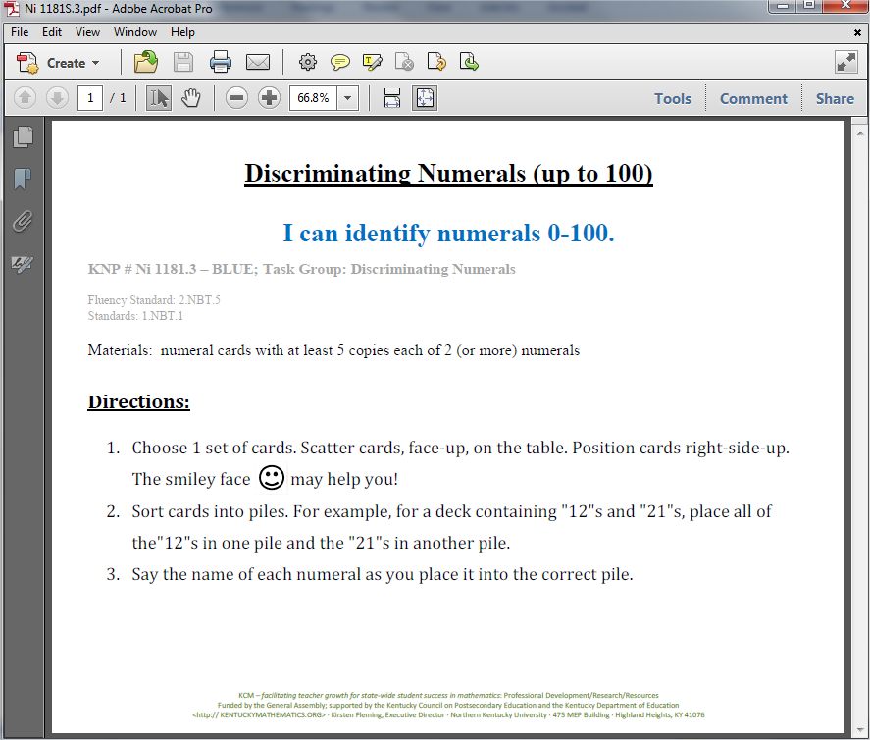
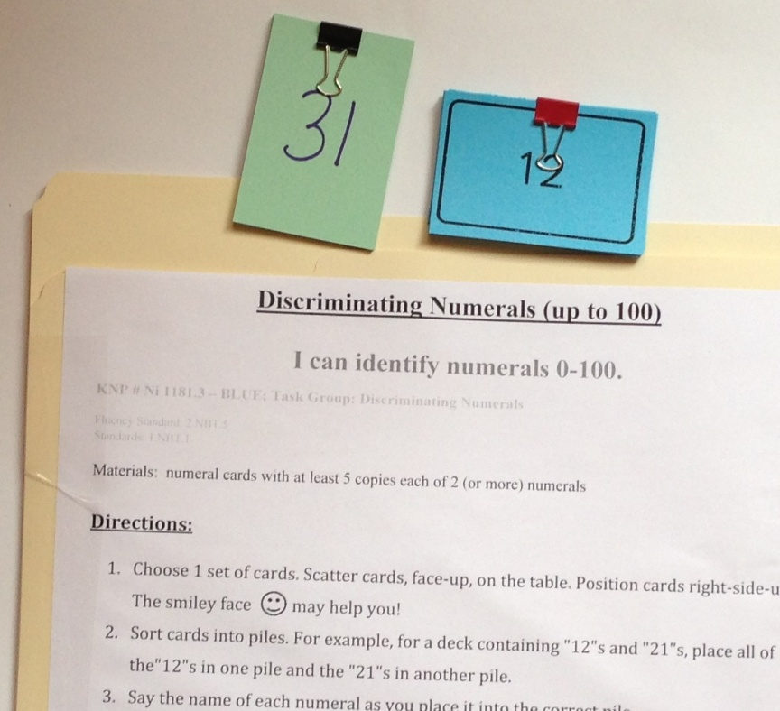
Student Directions & Activity Folders
Ni 1181
Notes:
Add picture of activity folder

Slide 21
Thank You!
Please visit knp.kentuckymathematics.org for more information.

