Slide 2
KNP Task Group M 4443 Multiplication and Arrays PowerPoints
An entry in the multiplication and division strand of the KNP Intervention Guide

Slide 3
Purpose
M 4443
Support students’ knowledge and ability to reason in the context of arrays.
Connect multiplicative language and ideas to arrays.
Describe arrays using addition and multiplication sentences.
Solve word problems in the context of arrays.

Slide 4
Standards
M 4443
2.OA.4 Use addition to find the total number of objects arranged in rectangular arrays with up to 5 rows and 5 columns; write an equation to express the total as a sum of equal addends.
3.OA.1 Interpret products of whole numbers, e.g., interpret 5 x 7 as the total number of objects in 5 groups of 7 objects each.

Slide 5
Standards
M 4443
3.OA.2 Interpret whole-number quotients of whole numbers, e.g., interpret 56 ÷ 8 as the number of objects in each share when 56 objects are partitioned equally into 8 shares, or as a number of shares when 56 objects are partitioned into equal shares of 8 objects each.
3.OA.3 Use multiplication and division within 100 to solve word problems in situations involving equal groups, arrays …
3.OA.6 Understand division as an unknown-factor problem.

Slide 6
Connections to CCSS
M 4443
Activity | Fluency Standard | Additional Standards targeted
M 4443.1 | 3.OA .7 Fluently multiply and divide within 100… | Foundational for 2.OA.4, 3.OA.1
M 4443.2 |  | 2.OA.4, 3.OA.1
M 4443.3 |  | 3.OA.1, 3.OA.3
M 4443.4 |  | 3.OA.1, 3.OA.3
M 4443.5 |  | 3.OA.2, 3.OA.3, 3.OA.6

Slide 7
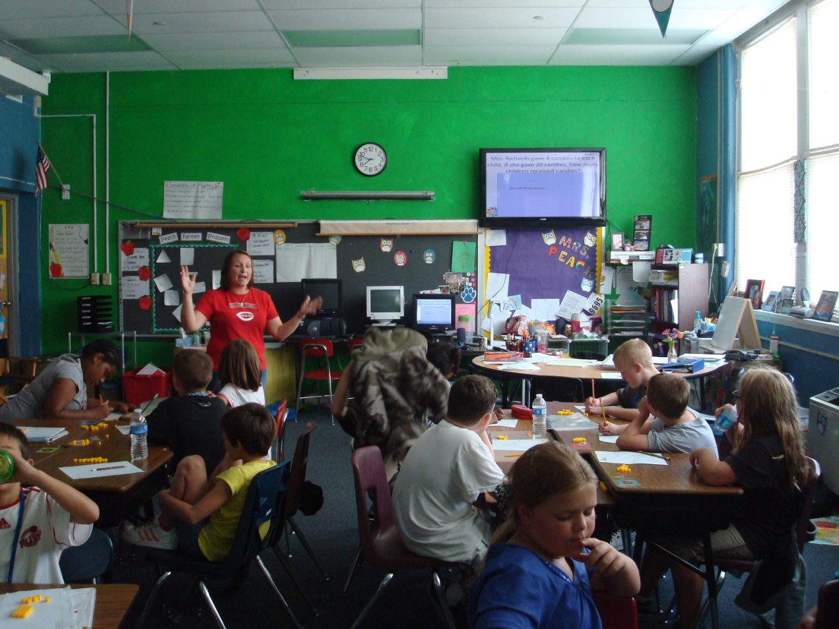
Setting
M 4443
PowerPoints
Individual and cooperative problem solving
Classroom discussion

Slide 8
M 4443.1
Introduction to Arrays PowerPoint
I can…
describe quantities arranged in equal groups and arrays

Slide 9
M 4443.1

Slide 10
M 4443.1
Click ENTER to make an array

Slide 11
Teacher Directions
M 4443.1
Display an image, leaving the image available for students to see and discuss
Give discussion prompts such as
Tell me something about this picture?
How many groups are there?
How many dots (items) are in each group? (Bring out words such as group, set, row, column and array and support students in using words correctly.)
Initially, do not ask students about the total number of dots. The purpose of this activity is to help students attend to and be able to communicate about the group structure of the image. If students are asked too soon about the total number of dots, students will likely resort to counting dots by ones with little or no attention to the structure.

Slide 12
Teacher Directions
M 4443.1
Additional activity prompts may include
Use counters to create what you see. (In place of counters, students could use dotted popsicle sticks or (for arrays) or dot strips.)
Draw what you see. (For the arrays, students could be given the option of recording images on a 10 by 10 empty dot array. Click here for pdf of the empty array. The array can be laminated or slipped into a page protector for repeated use. As an alternative to coloring in the array, students can “frame” the array using an L shaped paper. See next slide.)
Use a 10x10 bead rack to create what you see. (See next slide.)
These additional activities may help struggling students attend to the group structure and will give the teacher insight into what the student is attending to in the image.
Click HERE to skip to first image.

Slide 13
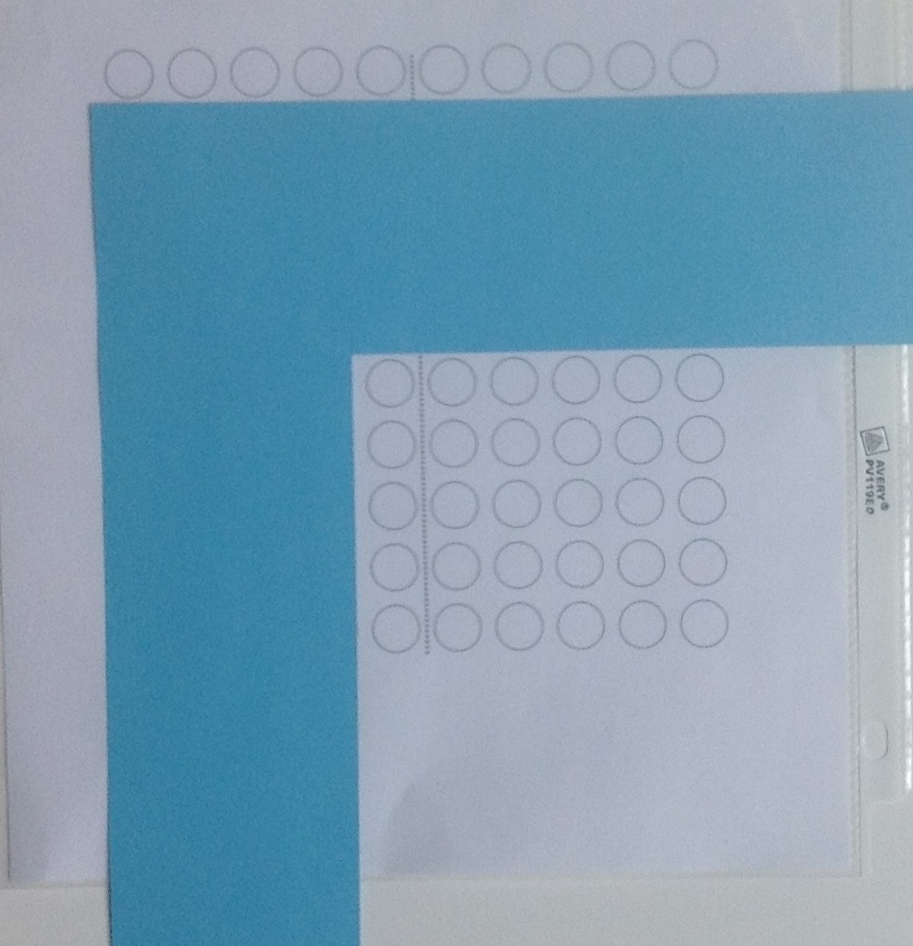
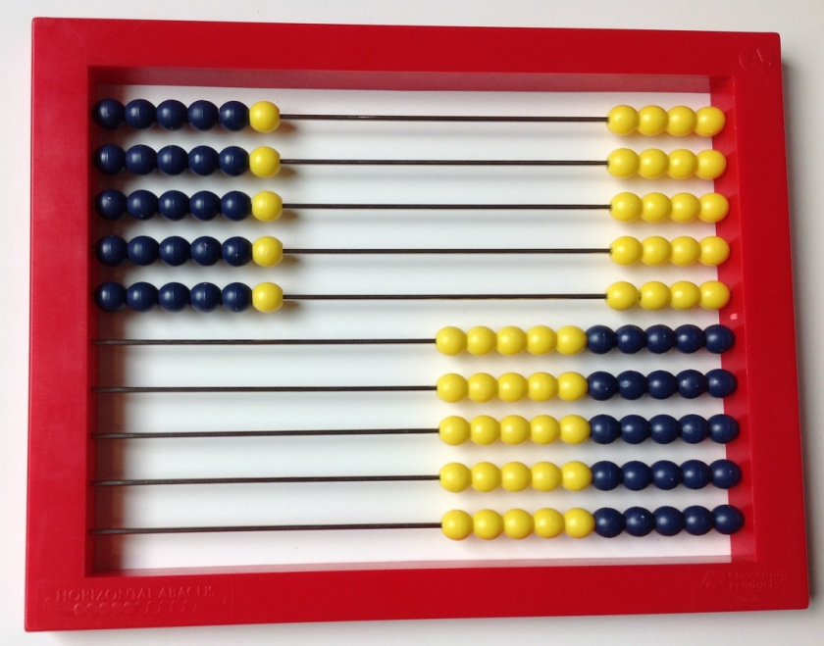
Examples for modeling a 5 x 6 array
Pictures
(top) 10 x 10 bead rack
(right) L shaped screen on a 10 x 10 array grid
Notes:
This slide is for teacher use and need not be shown to students. Highlight strategies that involve skip counting or stress counting (i.e. counting all items in one set before starting to count another). Less advanced students need experiences connecting skip counting to visible quantities.

Slide 14
M 4443.1
Click ENTER to make an array
Notes:
4 rows of 3, 4 groups of 3

Slide 15
M 4443.1
Click ENTER to make an array
Dotted Popsicle sticks are
Used in Task groups
M 4437, M 4441 & M 4442
Notes:
4 rows of 3, 4 groups of 3

Slide 16
M 4443.1
Click ENTER to make an array
Notes:
4 rows of 3, 4 groups of 3

Slide 17
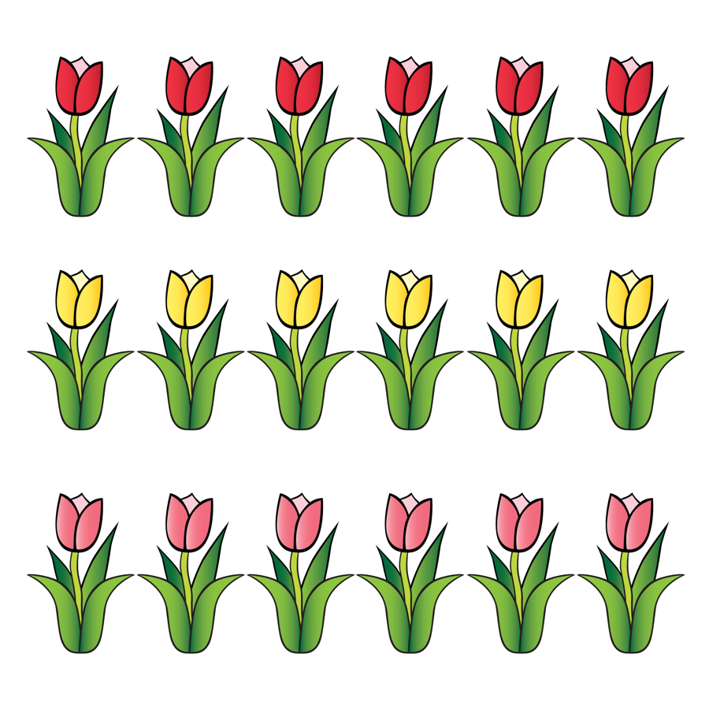
M 4443.1
Notes:
3 rows of 5

Slide 18
M 4443.2
Unscreened Arrays PowerPoint
I can…
determine how many items in all when items are arranged in an array or in equal groups. I can write an addition sentence to match the picture.

Slide 19
M 4443.2

Slide 20
M 4443.2
3
6
9
12
15
Click here for new image
Or choose ENTER to show skip counts.

Slide 21
Teacher Directions
M 4443.2
Display an image, leaving the image available for students to see and discuss.
Give discussion prompts such as
What do you see? (Look for language that shows students are seeing the organization of the dots, i.e. groups, rows, columns, array, etc.)
How are the dots organized?
How can we count the dots? Show me! What’s another way to count the dots? (For many of the images in the powerpoint, at least one skip counting sequence can be shown by repeatedly selecting ENTER. To omit the skip counting sequence, click on the link in the lower right corner. You may prefer to do your own recording for counting strategies using smart board tools or by writing directly on a white board. As an extension, you might ask students to consider if it’s easier to count by columns or rows.)
What is an addition sentence that matches this picture? (Eventually extend to asking for two addition sentences. For example, a 3 by 4 array matches 3+3+3+3=12 and 4+4+4=12.) It may be helpful to do this after the skip counting and while only the total number of dots is being displayed.
Notes:
This slide is for teacher use and need not be shown to students. Highlight strategies that involve skip counting or stress counting (i.e. counting all items in one set before starting to count another). Less advanced students need experiences connecting skip counting to visible quantities.

Slide 22
M 4443.2
3
We can skip count by 3s
6
We can also skip count by 5s
9
12
15
5
10
15
Notes:
5 groups of 5

Slide 23
M 4443.3
Partially Screened Arrays PowerPoint
I can…
determine how many items in all when items are arranged in an array but the items are hidden. I can write an addition sentence and a multiplication sentence to match the picture.

Slide 24
M 4443.3
Chose ENTER to uncover

Slide 25
M 4443.3
Chose ENTER to uncover

Slide 26
M 4443.3
Chose ENTER to uncover

Slide 27
M4443.4
Array word problems PowerPoint
I can…
solve word problems about arrays. I can write the matching multiplication sentence.

Slide 28
M 4443.4
Click HERE to skip to first image.

Slide 29
Teacher Directions
M 4443.4
Display the word problem. A supportive picture is hidden under the blue box. This picture may be revealed and used to support conversation about the task.
To support students’ problem solving, use prompts such as
What do we know?
What do we want to know?
How can we figure that out? (Some students may continue to use skip counting to solve. Others may “just know” some facts and may be able to anchor to know facts to work out others. For example, a student may use the known fact that 3x4 = 12 to work out 4x4 =16.)
Is there another way to solve this problem?
What is a multiplication sentence that matches this situation? (More than one multiplication sentence might apply. You may also wish to model writing the equation with a variable or “?” in the unknown position of the equation.)
Click HERE to skip to first image.
Notes:
This slide is for teacher use and need not be shown to students. Highlight strategies that involve skip counting or stress counting (i.e. counting all items in one set before starting to count another). Less advanced students need experiences connecting skip counting to visible quantities.

Slide 30
Examples for modeling a 5 x 6 array
M 4443.4
Pictures
(top) 10 x 10 bead rack
(right) L shaped screen on a 10 x 10 array grid
Click HERE to skip to first image.
Notes:
This slide is for teacher use and need not be shown to students. Highlight strategies that involve skip counting or stress counting (i.e. counting all items in one set before starting to count another). Less advanced students need experiences connecting skip counting to visible quantities.

Slide 31
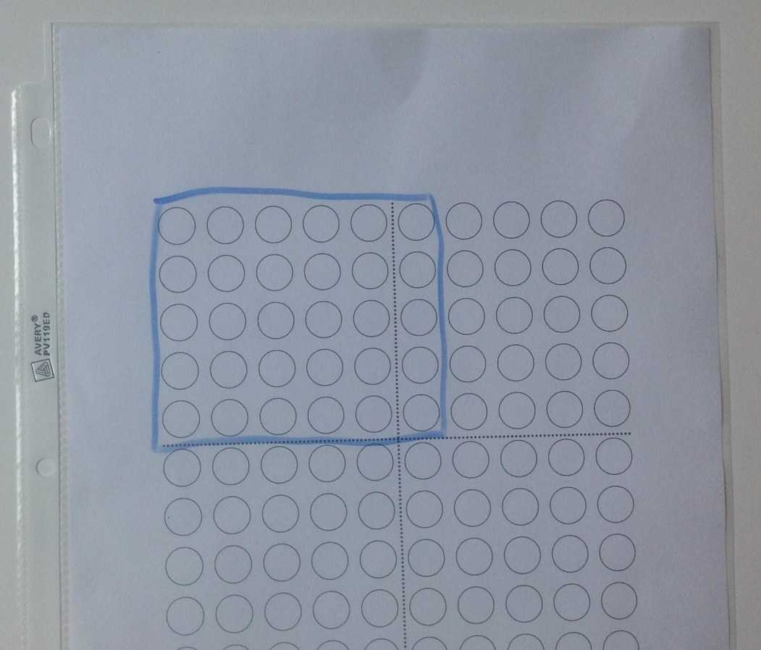
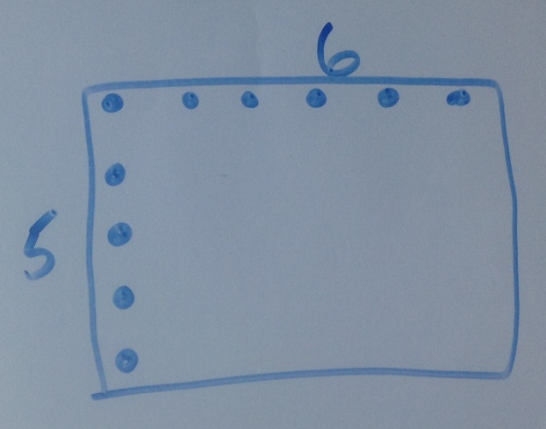
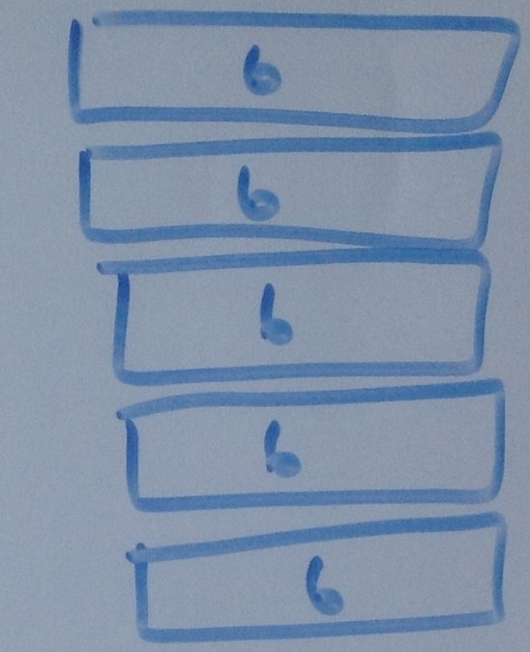
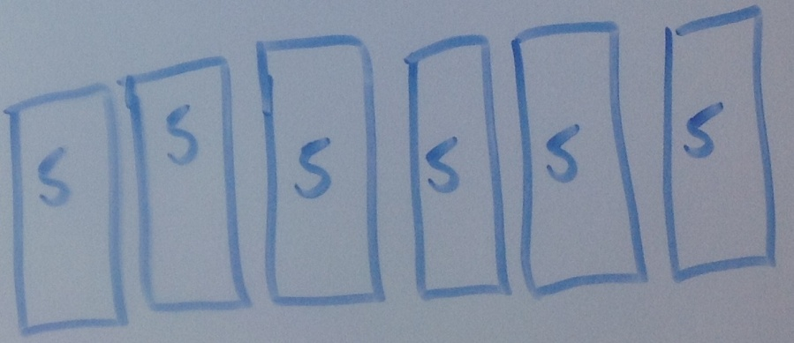
Examples for modeling a 5 x 6 array
M 4443.4
Pictures clockwise starting top
Array marked on a 10 x 10 grid
Array with only top row and first column marked
Diagram showing rows
Diagram showing columns
Notes:
This slide is for teacher use and need not be shown to students. Highlight strategies that involve skip counting or stress counting (i.e. counting all items in one set before starting to count another). Less advanced students need experiences connecting skip counting to visible quantities.

Slide 32
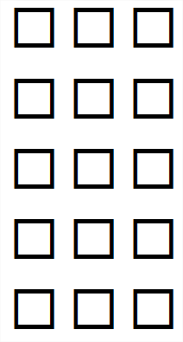
The tables are arranged in 3 rows. Each row has 5 tables. How many tables are there in all?
M 4443.4
Click ENTER to uncover
Notes:
And then reveal for discussion.

Slide 33
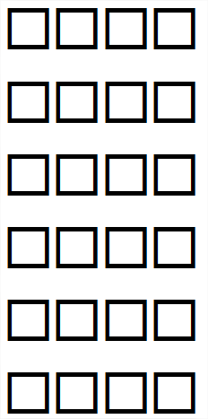
The Pokémon cards are placed in groups of 4. There are 6 groups. How many cards are there?
M 4443.4
Click ENTER to uncover
Notes:
And then reveal for discussion.

Slide 34
The grocer displays his apples in 3 rows and 4 columns. How many apples are in his display?
M 4443.4
Click ENTER to uncover
Notes:
And then reveal for discussion.

Slide 35
M 4443.5
Array word problems PowerPoint
I can…
solve word problems about arrays and equal groups. I can write the matching multiplication and/or division sentence.

Slide 36
M 4443.5
Click HERE to skip to first image.

Slide 37
M 4443.5
Partitive Division
Quotative Division

Slide 38
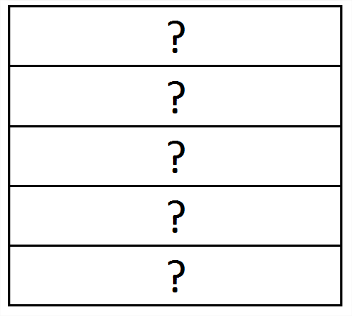
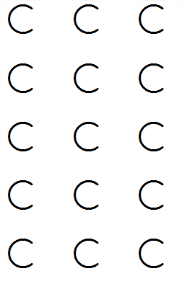
If 15 chairs are arranged into 5 rows, how many are in each row?
M 4443.5
Click “ENTER” to uncover
Click “ENTER” to uncover
Notes:
And then reveal for discussion.

Slide 39
Mrs. Richards gave 4 candies to each child. If she gave 20 candies, how many children received candies?
M 4443.5
Click “ENTER” to uncover
Click ENTER to uncover
How many groups of 4?
Notes:
And then reveal for discussion.

Slide 40
Caden has 16 cards. He wants to arrange them in an array. What is an array he can make so that no cards are leftover? What is another?
M 4443.5
Click “ENTER” to see some examples…
Notes:
And then reveal for discussion.

Slide 41
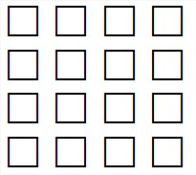
Arrays with 16 cards.
M 4443.5
4 x 4
2 x 8
1 x 16
Notes:
And then reveal for discussion.

Slide 42
Arrays with 16 cards.
M 4443.5
8 x 2
4 x 4
16 x 1
Also…
Notes:
And then reveal for discussion.

Slide 43
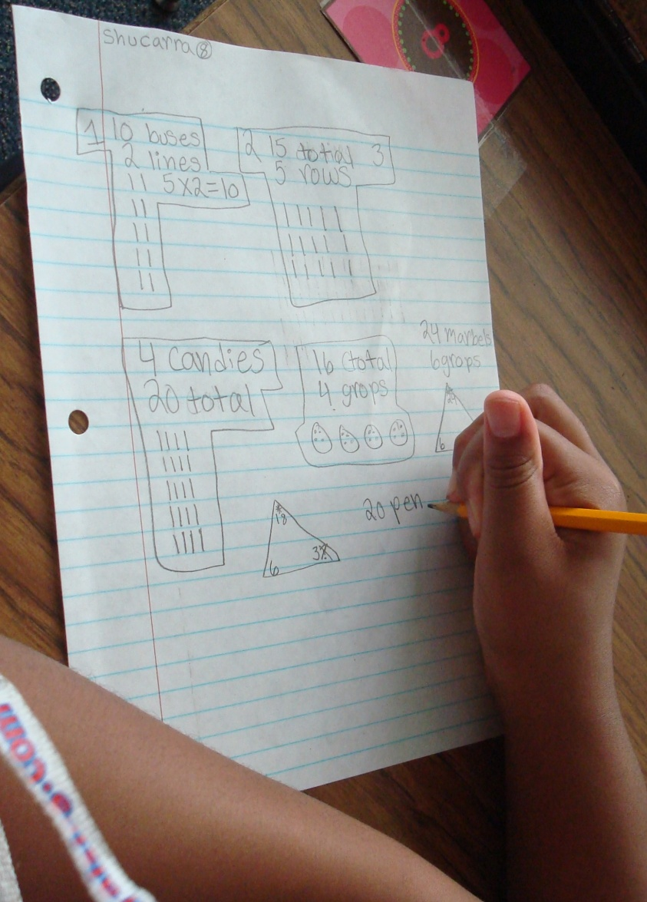
Student problem solving strategies
M 4443.5

Slide 44
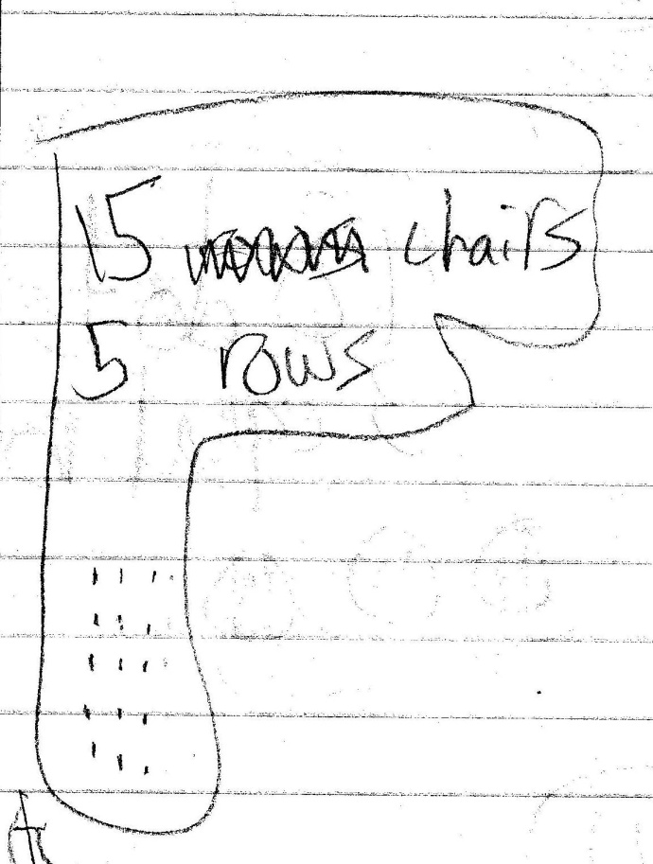
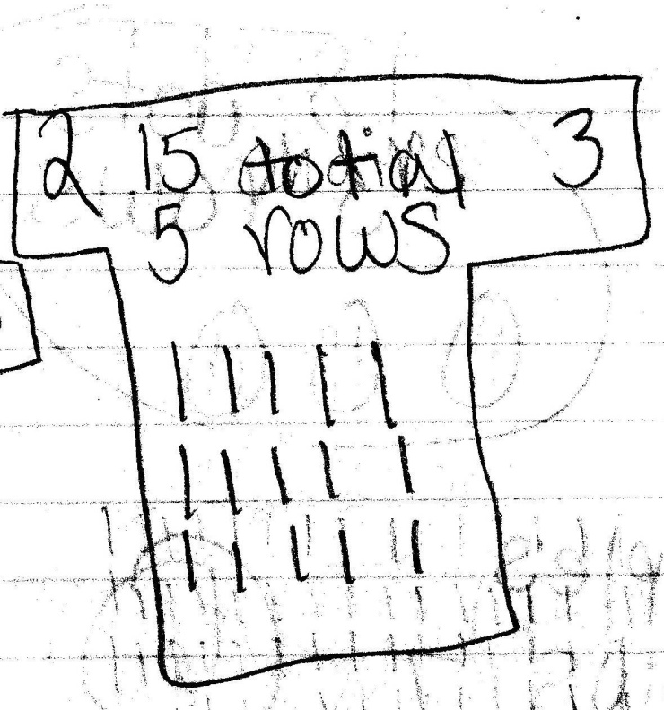
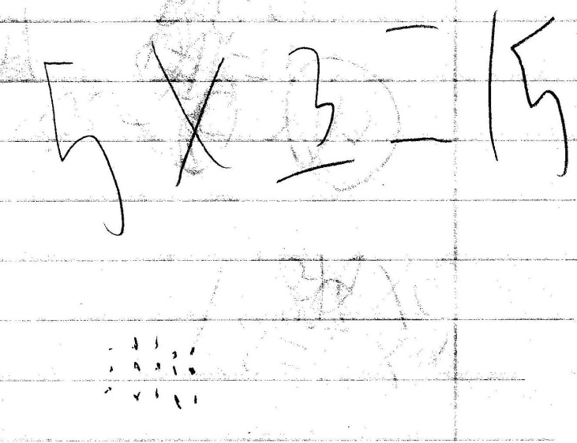
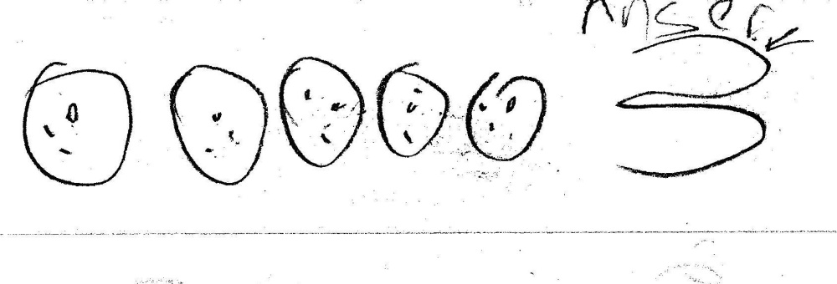
Written work for the task “15 chairs in 5 rows”.
M 4443.5

Slide 45
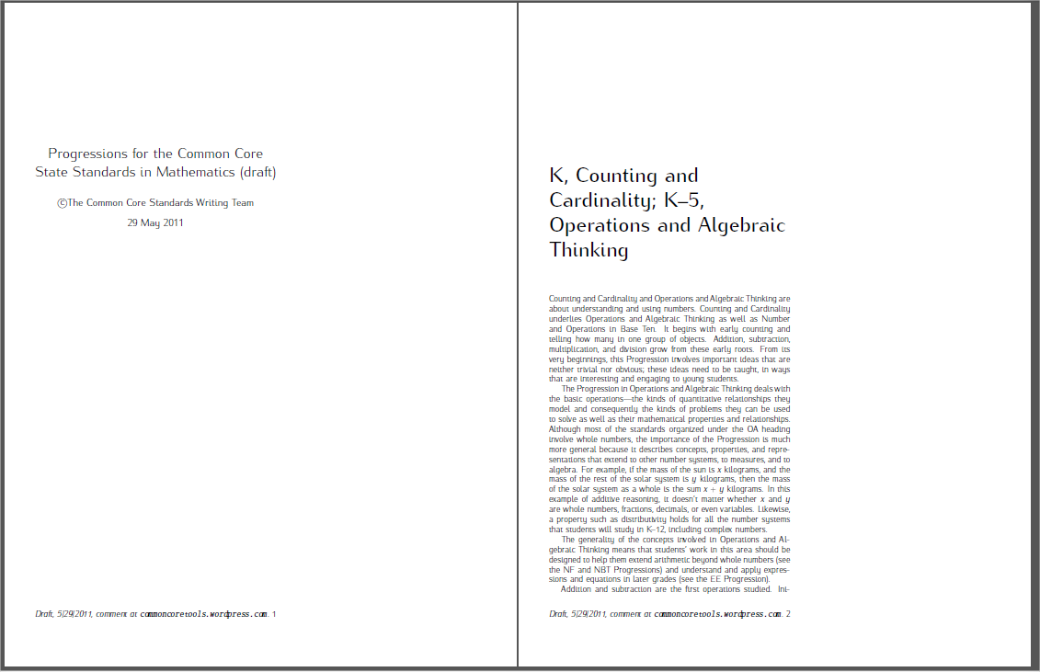
The following excerpts come from:
Progressions for the Common Core
State Standards in Mathematics (draft)
The Common Core Standards Writing Team
29 May 2011
This document is available at:
http://commoncoretools.me/2011/05/29/complete-draft-progression-for-cc-and-oa/
M 4443

Slide 46
M 4443
Levels in problem representation and solution
Multiplication and division problem representations and solution methods can be considered as falling within three levels related to the levels for addition and subtraction (see Appendix). Level 1 is making and counting all of the quantities involved in a multiplication or division. As before, the quantities can be represented by objects or with a diagram, but a diagram affords reflection and sharing when it is drawn on the board and explained by a student. ... 2.OA.4 focuses
on using addition to find the total number of objects arranged
in rectangular arrays (up to 5 by 5).
Level 2 is repeated counting on by a given number, such as for 3:
3; 6; 9; 12; 15; 18; 21; 24; 27; 30. The count-bys give the running total. The number of 3s said is tracked with fingers or a visual or physical (e.g., head bobs) pattern. For 8 x 3, you know the number of 3s and count by 3 until you reach 8 of them.
Page 25 – main text

Slide 47
M 4443
Supporting Level 2 methods with arrays
Small arrays (up to 5 x 5) support seeing and beginning to learn
the Level 2 count-bys for the first five equal groups of the small
numbers 2 through 5 if the running total is written to the right of
each row (e.g., 3, 6, 9, 12, 15). Students may write repeated
additions and then count by ones without the objects, often
emphasizing each last number said for each group. Grade 3
students can be encouraged to move as early as possible from
equal grouping or array models that show all of the quantities to
similar representations using diagrams that show relationships
of numbers because diagrams are faster and less error-prone
and support methods at Level 2 and Level 3. Some
demonstrations of methods or of properties may need to fall
back to initially showing all quantities along with a diagram.
(side box – page 25)

Slide 48
Thank You!
Please visit knp.kentuckymathematics.org for more information.

